Slide 1
Set Theory
Gayan Perera,
Pabasara Athukorala

Slide 2
Outline
Sets
Describing sets, notation, examples
Set equality
Membership relationships
Set Operations:
Union, Intersection, Complement and Difference
Venn Diagrams
De Morgan’s Laws for sets
Set partition
Cardinality, Power set ,Relations, Cartesian product, Functions

Slide 3
Set Theory
Set: Any well-defined collection of “objects.”
A = {a₁ ,a₂ , a₃, …, a_{n}} “A contains…”
Denote sets with upper-case letters, elements with lower-case letters.
Notations: The following notation is used to show set membership
a₁ ∈A “a₁ is an element of A” “a₁ is a member of A”
b₁ ∉A “b₁ is not an element of A”

Slide 4
Set Theory
If B is the set of letters in the English Alphabet, then we have, B = {a, b, c, ………, x, y, z }
We can write a ∈ B, b ∈ B, c ∈ B ,…… , z ∈B
Note: Number of elements of a given set A is denoted by n(A).
In the above example since the number of letters in the Alphabet is 26, n(B)=26.

Slide 5
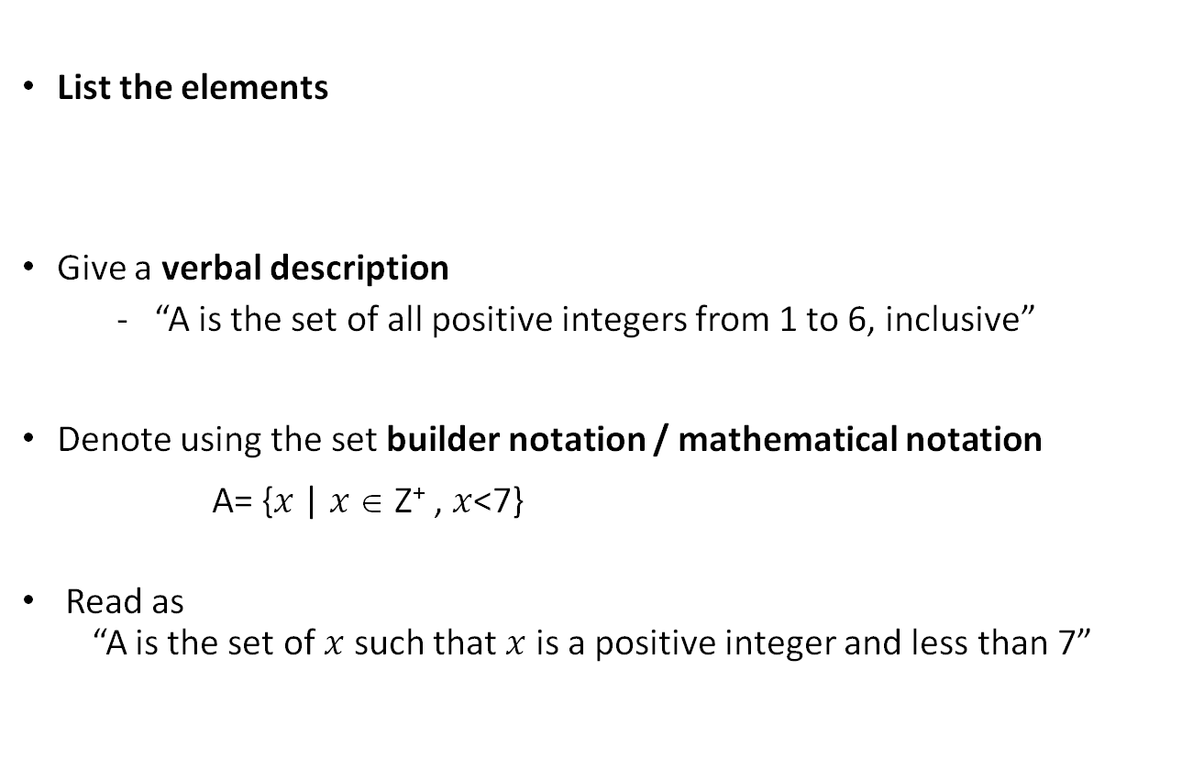
Ways of Describing Sets
List the elements
Give a verbal description
- “A is the set of all positive integers from 1 to 6, inclusive”
Denote using the set builder notation / mathematical notation
A= {$x$ | $x$ ∈ Z⁺ , $x$<7}
Read as
“A is the set of $x$ such that $x$ is a positive integer and less than 7”

Slide 6
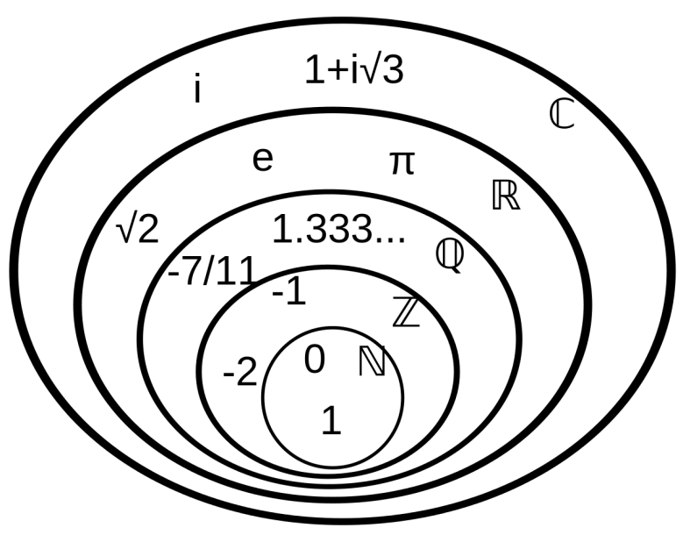
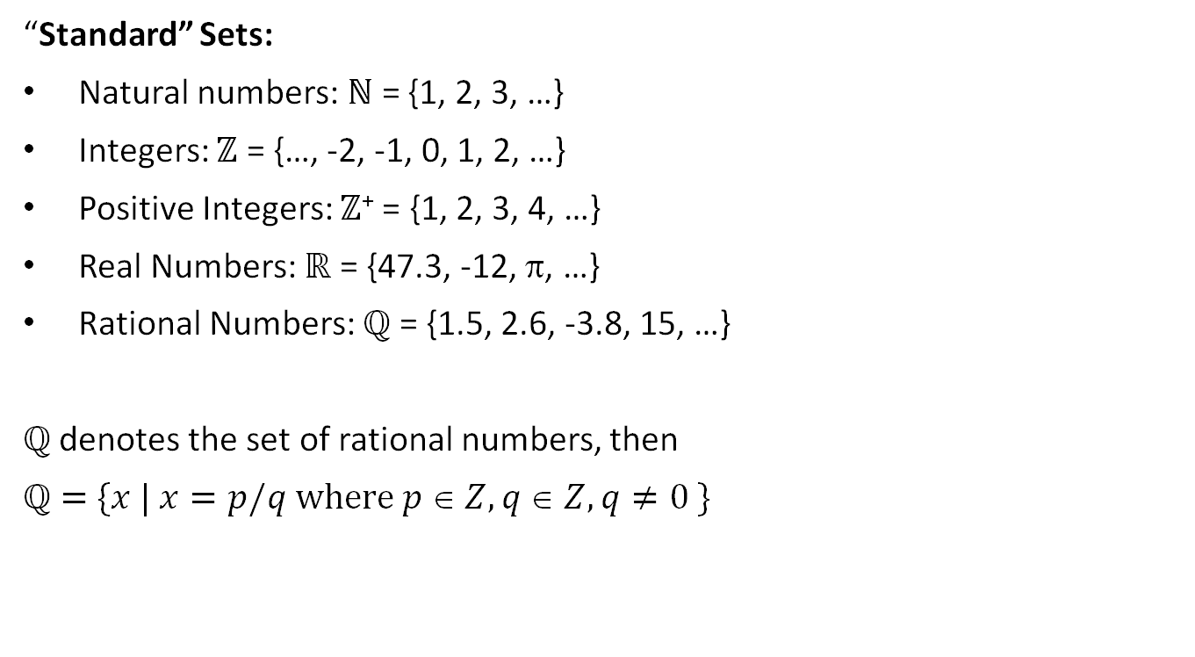
Examples for Sets
“Standard” Sets:
Natural numbers: $ℕ$ = {1, 2, 3, …}
Integers: $ℤ$ = {…, -2, -1, 0, 1, 2, …}
Positive Integers: $ℤ$⁺ = {1, 2, 3, 4, …}
Real Numbers: $ℝ$ = {47.3, -12, π, …}
Rational Numbers: $ℚ$ = {1.5, 2.6, -3.8, 15, …}
$ℚ$ denotes the set of rational numbers, then
$ℚ=$ $\{x | x=p/q where p  Z, q  Z, q≠0 \}$

Slide 7
Set Equality
Sets A and B are equal if and only if they contain exactly the same elements.
Example:
A = {9, 2, 7, -3}, B = {7, 9, -3, 2} :
A = B
Order of elements doesn’t matter.

Slide 8
Examples
1. Identify which sets are equal
A= {x | x is an integer where x>0 and x<5 }
B= {x | x is a positive integer whose square is >0 and <25}
C= {x | x is an integer whose square is >0 and <25}
2. Prove that A = {x: x is prime such that 1 < x < 10} and B = {2, 3, 5, 7} are equal sets.
3. Identify the equal sets.
A = {1, 2, 3, 4}, B = {x: x is a natural number less than 5}
A = {a, b, c, d}, B = {x: x is a vowel in English alphabet}
A = {1, 3, 5, 7, 9}, B = {x: x is an odd prime number less than 10}
A = {2, 4, 6, 8}, B = {1, 2, 4, 6, 8}

Slide 9
Some Special Sets
Null Set or Empty Set { }: This is a set with no elements, often symbolized by
Universal Set: This is the set of all elements currently under consideration, and is often symbolized by
Also symbolized by

Slide 10
Membership Relationships
Subset: We say “A is a subset of B” if
i.e., all the members of A are also members of B.
Notation: The notation for subset means, in terms of the sets, “included in or equal to.”
: “A is a subset of B”
Example:
B = {9, 2, 7, -3},
{9}, {9,2} ,{2,7,-3} are subsets of B and {9,2,7,-3} is also a subset of B

Slide 11
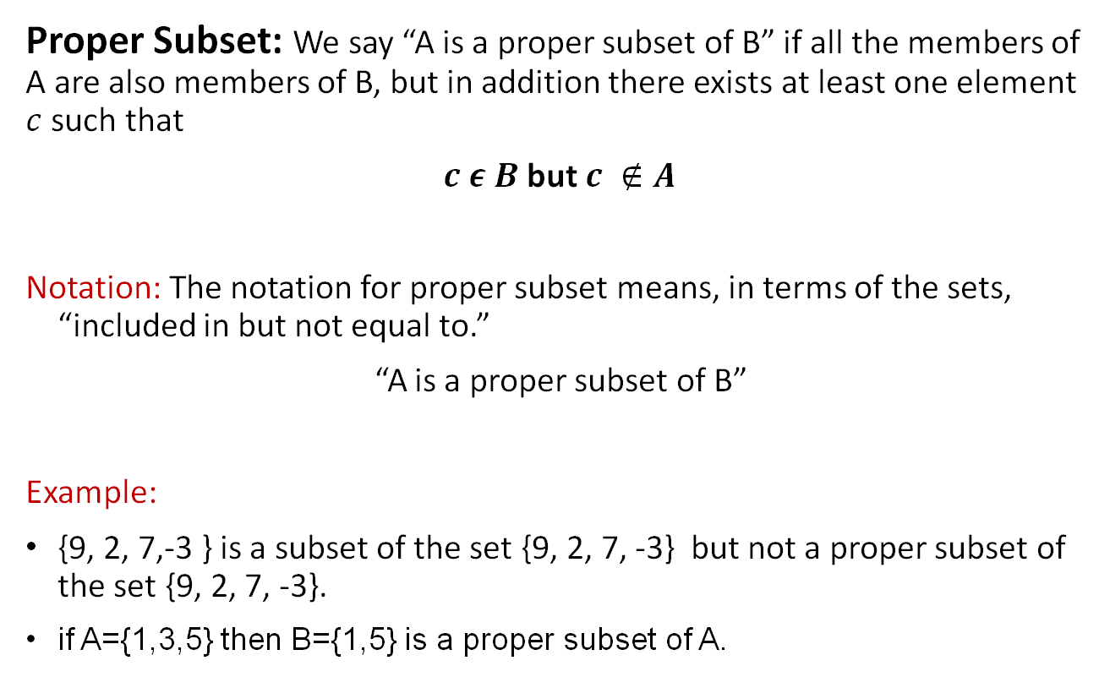
Membership Relationships
Proper Subset: We say “A is a proper subset of B” if all the members of A are also members of B, but in addition there exists at least one element $c$ such that
$c ε B$ but $c ∉A$
Notation: The notation for proper subset means, in terms of the sets, “included in but not equal to.”
“A is a proper subset of B”
Example:
{9, 2, 7,-3 } is a subset of the set {9, 2, 7, -3} but not a proper subset of the set {9, 2, 7, -3}.
if A={1,3,5} then B={1,5} is a proper subset of A.

Slide 12
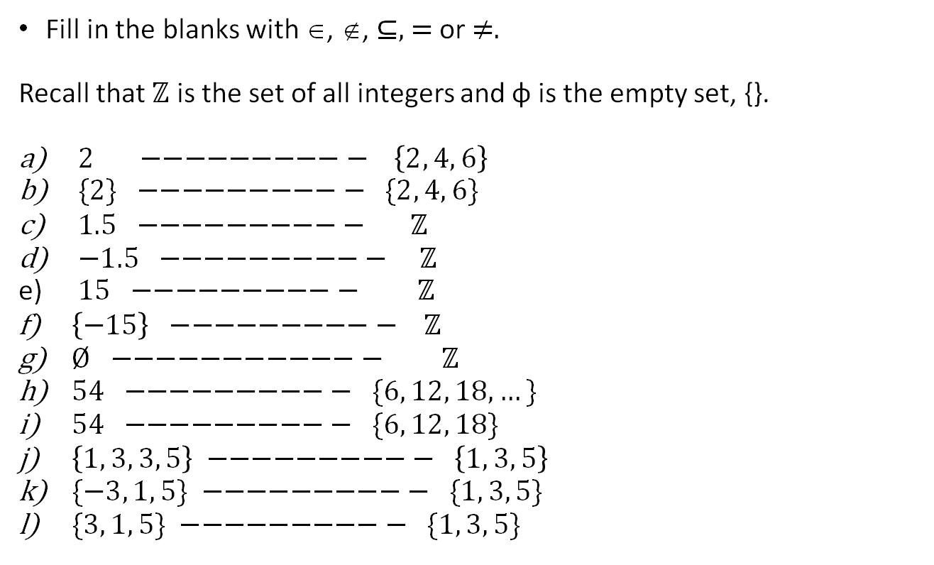
Questions
Fill in the blanks with ∈, ∉, ⊆, = or ≠.
Recall that $ℤ$ is the set of all integers and φ is the empty set, {}.
$2 −−−−−−−−−− \left\{2, 4, 6\right\}$
$\{2\} −−−−−−−−−− \{2, 4, 6\}$
$1.5 −−−−−−−−−− ℤ$
$−1.5 −−−−−−−−−− ℤ$
$15 −−−−−−−−−− ℤ$
$\left\{−15\right\} −−−−−−−−−− ℤ$
$Ø −−−−−−−−−−−− ℤ$
$54 −−−−−−−−−− \{6, 12, 18, …\}$
$54 −−−−−−−−−− \{6, 12, 18\}$
$\left\{1, 3, 3, 5\right\} −−−−−−−−−− \left\{1, 3, 5\right\}$
$\{−3, 1, 5\} −−−−−−−−−− \{1, 3, 5\}$
$\{3, 1, 5\} −−−−−−−−−− \{1, 3, 5\}$

Slide 13
Combining Sets – Set Union
Notations:
“A union B” is the set of all elements that are in A, or B, or both.
Example:

Slide 14
Combining Sets – Set Intersection
Notations:
“A intersect B” is the set of all elements that is in both A and B.
Example:

Slide 15
Set Complement
Notations:
“A complement,” or “not A” is the set of all elements not in A.
Example:

Slide 16
Set Difference
Notation:
The set difference “A minus B” is the set of elements that are in A, with those that are in B subtracted out.
Another way of putting it is, it is the set of elements that are in A, and not in B, so
Example:

Slide 17

Questions
Answer the following questions using the information given.
U = {1, 2, 3, 4, 5, 6, 7, 8, 9, 10}
A = {2, 4, 6, 8, 10}
B = {1, 3, 7}
C = {3, 7}
Find
a) Subsets of C
b) Proper subsets of B
$A ∩ B , A ∪ C , A’ , B’ , B ∩ A’ , B ∩ C’ , A − B$

Slide 18
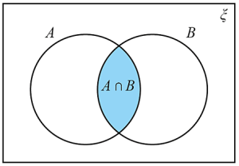
Venn Diagrams
Venn Diagrams use topological areas to stand for sets.

Slide 19
Exercise - Venn Diagrams
Identify the regions in separate Venn diagrams for following:
a. A ∪ B
b. A’ (also symbolized by )
c. B’ (also symbolized by )
d. A - B

Slide 20
Venn Diagrams
Shade the identified region in the following expressions

Slide 21
De Morgan’s Law for Sets
Let’s use Venn Diagrams to verify DeMorgan’s law

Slide 22
De Morgan’s Law for Sets

Slide 23
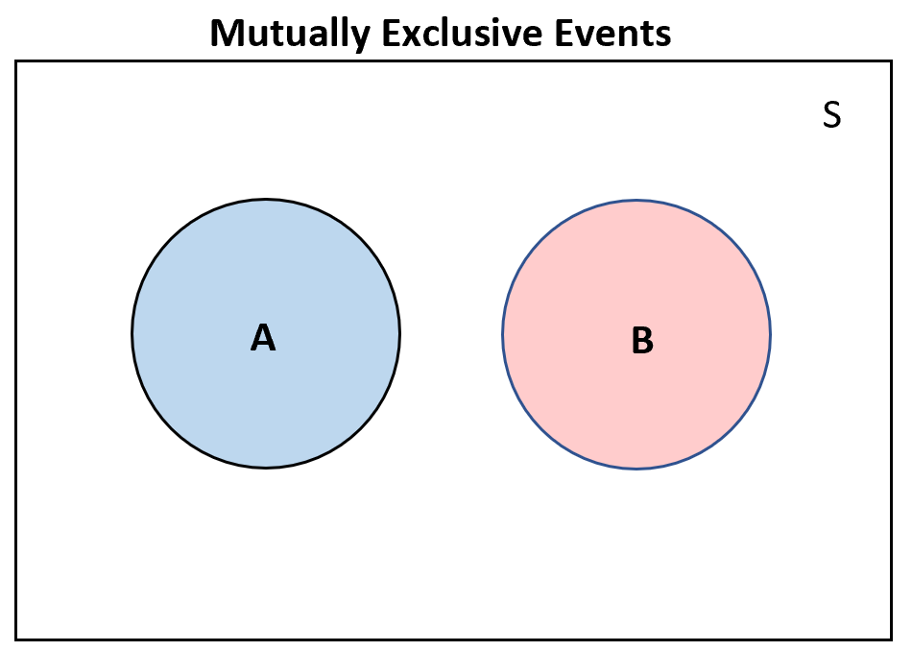

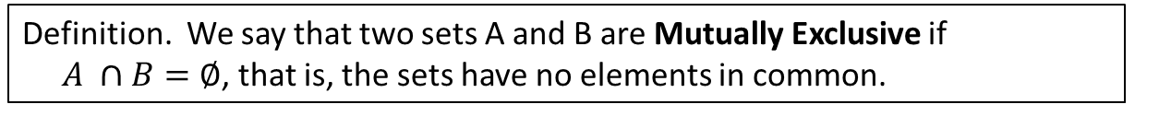
Mutually Exclusive and Exhaustive Sets
Definition. We say that a group of sets is Exhaustive of another set if their union is equal to that set.
Example: if $A∪B=C$we say that A and B are exhaustive with respect to C.
Definition. We say that two sets A and B are Mutually Exclusive if
$A ∩B=∅$, that is, the sets have no elements in common.

Slide 24
Set Partition
Definition: We say that a group of sets partitions another set if they are mutually exclusive and exhaustive with respect to that set.
When we “partition a set,” we break it down into mutually exclusive and exhaustive regions. (i.e., regions with no overlap.)
The Venn diagram below should help you get the picture.
In this diagram, the set A (the rectangle) is partitioned into sets W,X, and Y.

Slide 25
Some Test Questions
Notes:
A

Slide 26
Some Test Questions
Notes:
Universal set (omega or epsilon)

Slide 27
Some Test Questions
Notes:
Empty set

Slide 28
Some Test Questions
Notes:
Universal set

Slide 29
Some Test Questions
Notes:
A

Slide 30
Some Test Questions
Notes:
A (A is included in B)

Slide 31
Some Test Questions
Notes:
B (A is included in B, but there is at least once element in B that we need to consider)

Slide 32

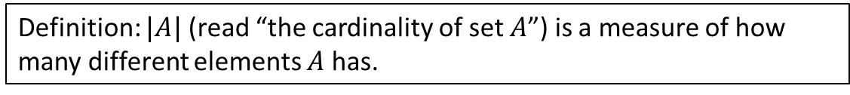
Cardinality and Finiteness
Definition: $|A|$ (read “the cardinality of set $A$”) is a measure of how many different elements $A$ has.
Same as $n(A)$.
Examples:
$|  |=0,$
$$\left| \left\{1,2,3\right\}\right|= 3,$$
$| \{a,b\} | = 2,$ $$| \{ \{1,2,3\},\{4,5\} \} | = 2$$
We say $A$ is infinite if it is not finite.
What are some infinite sets we’ve seen?
N
Z
R

Slide 33

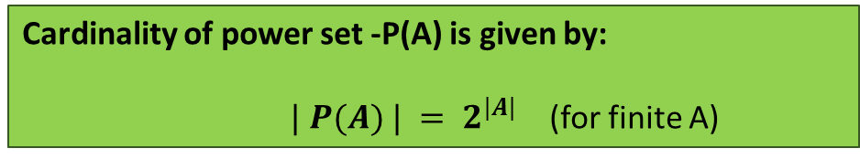
The Power Set Operation
Definition: The power set P(A) of set A is the set of all subsets of A.
Notation: $P\left(A\right)= \left\{x \right| x ⊆ A\}.$
Example: If $A=\{a,b \}$then $P(A) = \{∅, \{a\}, \{b\}, \{a,b\}\}.$
It turns out that $|P(A)| > |A|.$
Cardinality of power set -P(A) is given by:
$| P(A) | = 2^{|A|}$(for finite A)

Slide 34
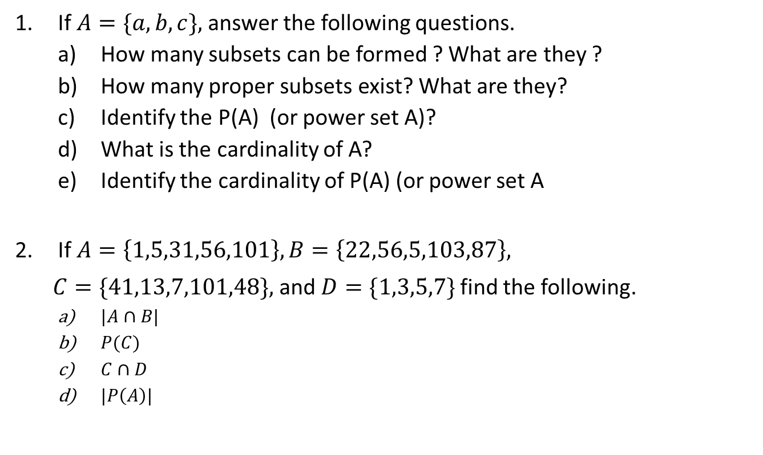
Questions
If $A=\{a,b,c\},$answer the following questions.
How many subsets can be formed ? What are they ?
How many proper subsets exist? What are they?
Identify the P(A) (or power set A)?
What is the cardinality of A?
Identify the cardinality of P(A) (or power set A
If $A=\left\{1,5,31,56,101\right\}, B=\left\{22,56,5,103,87\right\},$
$C=\{41,13,7,101,48\},$and $D=\{1,3,5,7\}$find the following.
$|A∩B|$
$P(C)$
$C∩D$
$|P\left(A\right)|$
Notes:
Use Cardinality of a power set A to find the different number of combinations of sets.

Slide 35
Counting and Venn Diagrams
Example 1: In a class of 50 college freshmen, 30 are studying BASIC, 25 are studying PASCAL, and 10 are studying both. How many freshmen are studying either computer language?
U
5
A
B
20
10
15

Slide 36
Counting and Venn Diagrams (Con.)
A
B
a
b
c
e
d
f
g
C

Slide 37

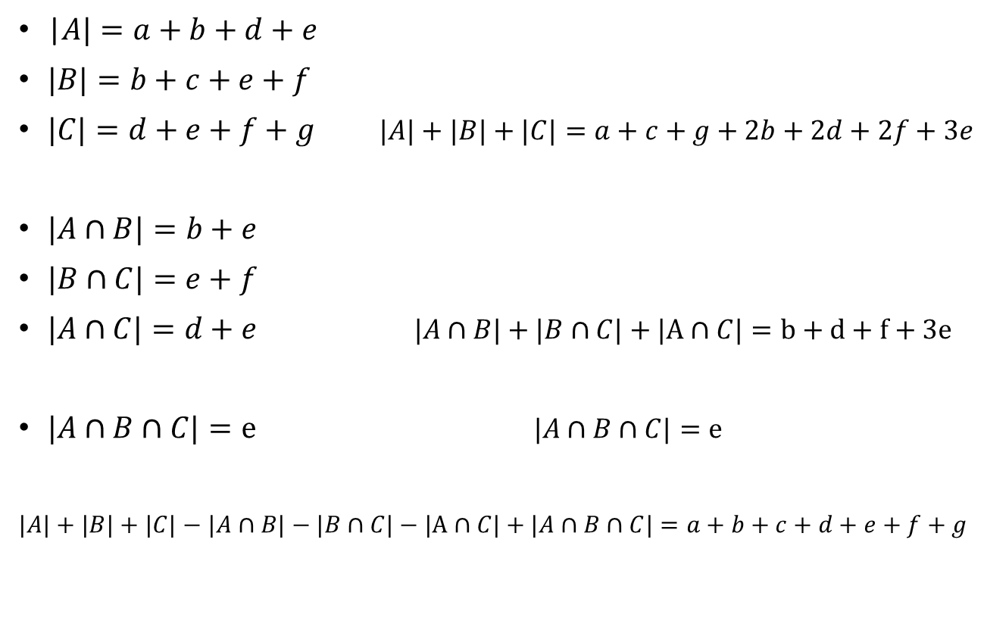
A
B
a
b
c
d
e
f
g
|$A|=a+b+d+e$
$|B|=b+c+e+f$
$|C|=d+e+f+g$ $|A|+|B|+|C|=a+c+g+2b+2d+2f+3e$
$|A∩B|=b+e$
$|B∩C|=e+f$
$|A∩C|=d+e$ $|A∩B|+|B∩C|+|A∩C|=b+d+f+3e$
$|A∩B∩C|=e$ $|A∩B∩C|=e$
$|A|+|B|+|C|−$ $|A∩B|−|B∩C|−|A∩C|+$ $|A∩B∩C|=a+b+c+d+e+f+g$
C
+
$$=|A∪B∪C|$$

Slide 38
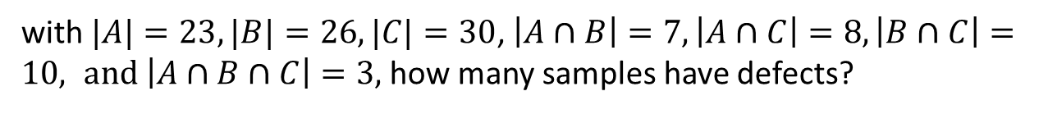
Example 2: Defect types of a product:
D1: Level 1 Defect
D2: Level 2 Defect
D3: Level 3 Defect
Given 100 samples
set A: with D1
set B: with D2
set C: with D3
with $|A|=23, |B|=26, |C|=30$, $\left|A∩B\right|=7, \left|A∩C\right|=8, \left|B∩C\right|=10, and \left|A∩B∩C\right|=3,$ how many samples have defects?

Slide 39

Counting and Venn Diagrams (Con.)
$\left|A\right|=23,$
$\left|B\right|=26,$
$|C|=30$,
$\left|A∩B\right|=7,$
$\left|A∩C\right|=8,$
$\left|B∩C\right|=10,$
$\left|A∩B∩C\right|=3$
B
A
12
11
4
43
3
7
5
15
C
$$\left|A∪B∪C\right|=\left|A\right|+\left|B\right|+\left|C\right|−\left|A∩B\right|−\left|A∩C\right|−\left|B∩C\right|+|A∩B∩C|$$
Ans:57
Notes:
Common defects in A and C represent the intersection of A and C.

Slide 40
Questions
In a class there are 30 students. 21 students like Mathematics, 16 like English, 6 students do not like Mathematics or English. How many Students like both Mathematics and English?
In a class there are 8 students who play football and hockey, 7 students who do not play football or hockey, 13 students who play hockey, 19 students who play football. How many student are there in the class?

Slide 41
Questions
The following data refers to random sample of 200 attending a seminar; they are categorized according to their education qualifications.
There are 115 BSc Engineers, 100 CIMA qualified people and 70 AAT qualified people. 40 are both BSc and CIMA qualified. 50 are both CIMA and AAT qualified. 20 BSC Engineers are AAT qualified. 10 have no qualification.
Required: Find the no of people who have all three qualifications?

Slide 42

Laws of the Algebra of Sets
Idempotent laws
$A∪A=A$
$A∩A=A$
Associative laws
$\left(A∪B\right)∪C=A∪(B∪C$)
$\left(A∩B\right)∩C=A∩\left(B∩C\right)$
Commutative laws
$A∪B=B∪A$
$A∩B=B∩A$

Slide 43

Laws of the Algebra of Sets
Distributive laws
$A∪\left(B∩C\right)=\left(A∪B\right)∩\left(A∪C\right)$
$A∩\left(B∪C\right)=(A∩B)∪(A∩C)$
Identity laws
$A∪∅=A A∩Ω=A$
$A∪Ω=Ω A∩∅=∅$
Involution law
$\overline{\overline{A}}=A$ or $A^{′^{′}}=A$

Slide 44

Laws of the Algebra of Sets
Complement laws
$A∪A^{′}=Ω$ $A∪A^{′}=∅$
$Ω^{′}=∅ ∅^{′}=Ω$
De Morgan’s laws
$(A∪B)′=A′∩B′$
$(A∩B)′=A′∪B′$

Slide 45
Thank You!

